Slide 1
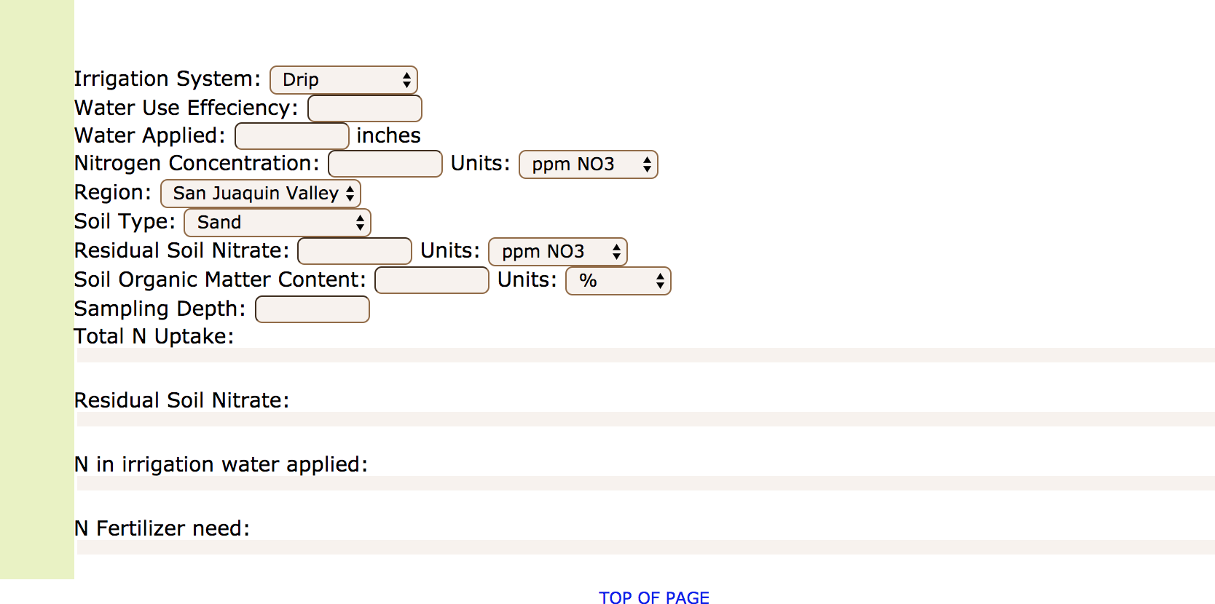
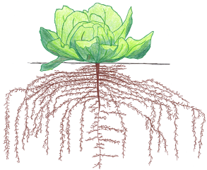
In general, drip or sprinkler systems can distribute water more uniformly across the field than flood irrigation, making it easier to ensure that excess water at the head of the field does not leach soil nitrate below the root zone. Therefore, crops usually are able to take up more of the applied fertilizer N with these irrigation systems. The leaching risk is greatest in sandy soils.

Slide 2
Nitrogen use efficiency depends strongly on efficient water management, and the two cannot be considered separately. This is because nitrate moves with water, whether water is taken up by plant roots, leached below the root zone, or lost from the field as runoff.
Some practices which increase water use efficiency include ^{[1,2]}:
Irrigating based on predicted crop water use (evapotranspiration, ET)
Good maintenance on irrigation system, check flow rates and distribution uniformity
Shorter checks for flood-irrigated fields
Dig deeper! Watch a presentation by UCANR advisor Richard Snyder on using ET to improve water use efficiency. (https://www.youtube.com/watch?v=pcBZzemUHqw) Also check out Fresno State’s irrigation scheduling tool. (http://www.wateright.net/Login?ReturnUrl=%2fmembers%2fagschedule.aspx)
^{[1]} Bali, K.M., 2012a. It’s time to check your sprinkler system. Imperial County Agricultural Briefs, September 2012.
^{[2]} Bali, K.M., 2012b. Improving flood irrigation systems efficiency. Imperial County Agricultural Briefs, December 2012.
A single excessive irrigation can leach soil and fertilizer nitrate below the root zone of a shallow-rooted crop.

Slide 3
Irrigation water can contain significant amounts of N in the form of nitrate, especially if well water is used. This nitrate is plant-available, and should be counted towards the crop’s total N requirement. To account for leaching losses, only the nitrate in the water taken up by crops is generally taken into account.
Dig deeper! UCCE advisors Mike Cahn and Richard Smith explain how irrigation water nitrate is credited towards the crop’s total N requirement. (http://ucanr.edu/blogs/blogcore/postdetail.cfm?postnum=9361)

Slide 4
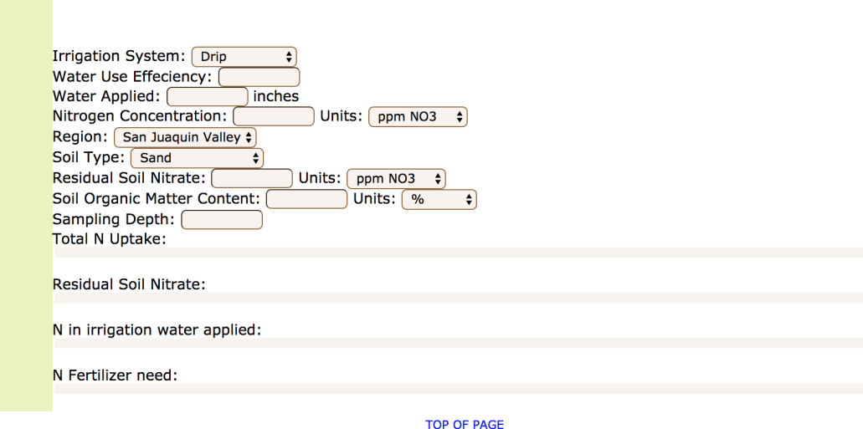
Reports of soil and water analyses generally report nitrate or nitrate-N concentration in mg/kg or ppm (parts per million). The two units mg/kg and ppm are interchangeable. Values for nitrate can be multiplied by 0.226 to obtain nitrate-N (the amount of N contained in the nitrate). With one acre-inch of water with a nitrate-N concentration of 10 ppm, 2.27 lbs N/acre are applied to the field. With one acre-foot of the same water, 27.2 lbs N/acre are applied.

Slide 5
Soil holds water by friction with soil surfaces. Sandy soils, which have low surface area and large pores, allow water to infiltrate and drain quickly, and cannot hold much water. Clay soils have more surface area and smaller pores, so water drains more slowly and spreads horizontally. Sandy soils have a greater risk of N leaching past the root zone and contaminating the groundwater, while clay soils have a greater risk of becoming waterlogged, reducing root ability to take up nutrients and leading to nitrate being lost to the atmosphere as nitrogen gas or nitrous oxide. For both soil types, the best strategy is to match water and N applications to predicted crop demand.
Dig deeper! Play with the online Fertigation Tool see how soil type interacts with water and N management to affect resource distribution.

Slide 6

Soil test nitrate gives a snapshot of how much N is currently available for plant uptake in the soil. This value can be used to adjust the fertilizer N application rate. Residual N can easily be lost by leaching, so the test should be done as close as possible to a planned fertilizer application. The soil sample should be representative of the plant rooting zone. Instructions for taking a good soil sample can be found here.
A nitrate-N concentration of 10 ppm in one foot of the soil profile corresponds to roughly 30-40 lbs N/acre.
Dig deeper! Residual soil nitrate can be measured on-farm using a soil nitrate quick test. Find out how to use it here. You can also get in-depth practical instructions for using soil nitrate tests here.

Slide 7
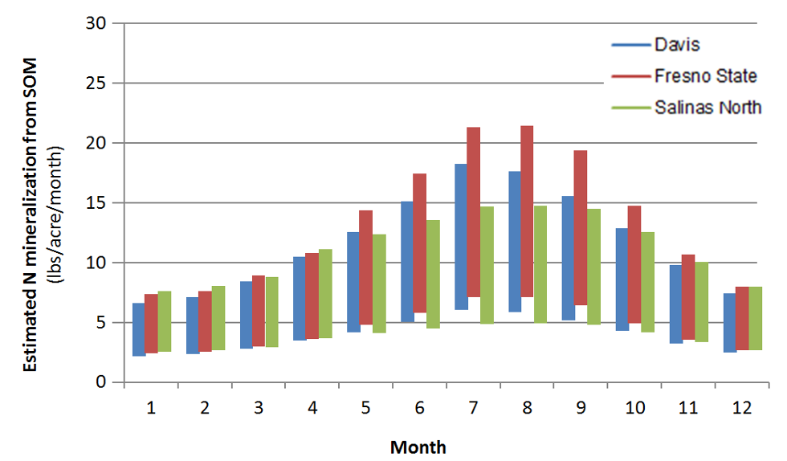
The breakdown of soil organic matter into mineral form (mineralization) can provide significant amounts of plant available N. Generally 1-3% of soil organic N is mineralized during the growing season ^{[1]}. Many factors affect N mineralization, most importantly soil temperature, which varies considerably during the year. In dry soil, N mineralization is much slower. Therefore, in drip irrigated fields, the amount of N mineralized per acre is reduced, as only part of the soil volume is kept moist.
Estimated monthly N mineralization rates from soil organic matter based on monthly average temperature in a soil with an organic matter content of 2% in the top foot of the profile ^{[2]}.
^{[1]} Bremner, J.M., 1995. Recent research on problems in the use of urea as a nitrogen fertilizer. Fertilizer Research 42, 321-329.
^{[2]} Geisseler, D., Lazicki, P., Horwarth, W.R., 2015. Field specific nitrogen fertilization adjustments. Available online at : https://apps1.cdfa.ca.gov/FertilizerResearch/docs/Adjustments.html

Slide 8
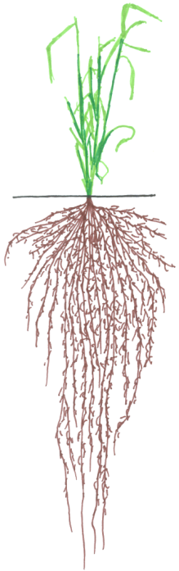
The sampling depth should reflect the main rooting zone of the plant. For most vegetable crops this is about 6-12 inches, and for most field crops the top two feet are taken separately. Although many crops root much more deeply, for routine sampling the top two feet are normally sufficient since this is where most nutrient uptake takes place.

